Slide 1
Animalia

Slide 2
Animalia
Notes:
Graeme Base’s Animalia (Library Edition) takes kids of all ages on a stimulating learning adventure through one of the world’s most beloved and well-known picture books - Animalia. It brings to life all the major characters from the book as they host a range of interactive activities exploring the intricate detail of Graeme’s amazing artwork. This resource features a new animated story, ‘The ABC of Flying’. Download the app.
Animalia (Library Edition) can be downloaded on 4 platforms:
Mobile devices: App Store (Apple iPad); App not available for iPhone
Google Play (Android) – demo on screen
On a pc: Clicking on the links below will commence direct download of the software. Click "Run" to continue installation.
Mac installer
Windows setup
This information is on the PLC eresources page & as a link from the RLQ Aurora Montage homepage.

Slide 3
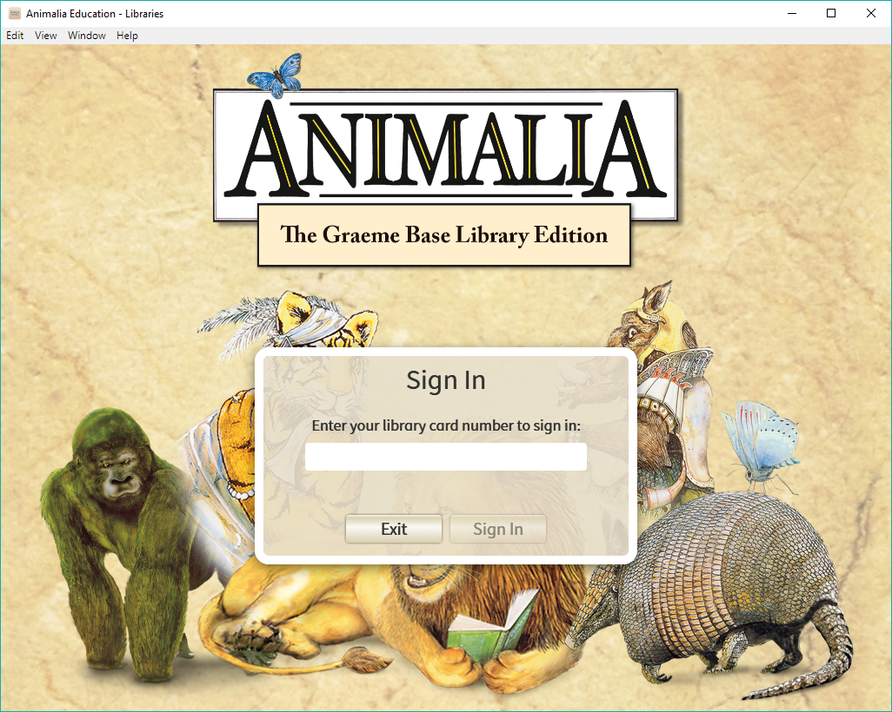
Animalia slq123
Notes:
Open the app. Sign in using the code: slq123 (No need to sign in with your library number)
Connect online to sign in, each time you open the app. Then use the app offline

Slide 4
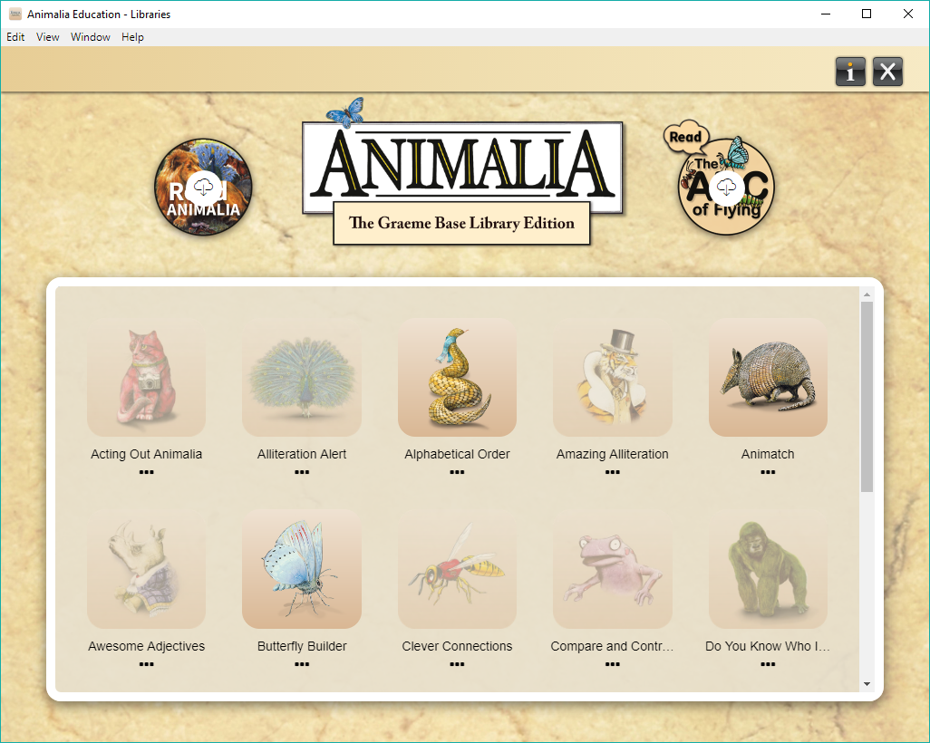
Animalia
Notes:
There are 2 digital versions of the books Animalia and The ABC of Flying along with 19 associated activities.
You only need to be online to sign in and download the books & activities. Once the applications are loaded onto a device, you do not need to be online to complete activities.
Activities include Alphabetical Order, Amazing Alliteration, Compare and Contrast, and Vexing Vocabulary, with different levels of complexity for each activity catering for a range of ages & abilities.

Slide 5
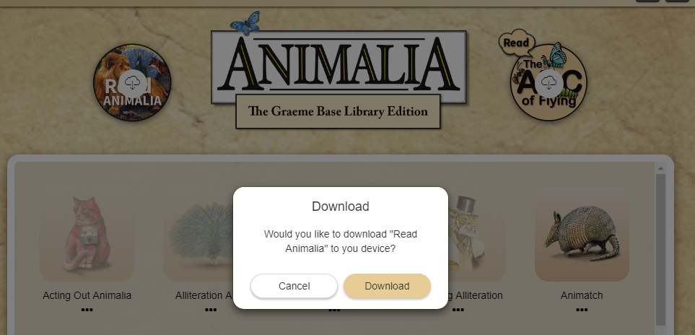
Animalia
Notes:
Each book – ‘Animalia’ and ‘The ABC of flying’ has a cloud symbol signifying the need to download the book.
Once downloaded – the icon will change from the cloud symbol to READ & you can open the book.

Slide 6
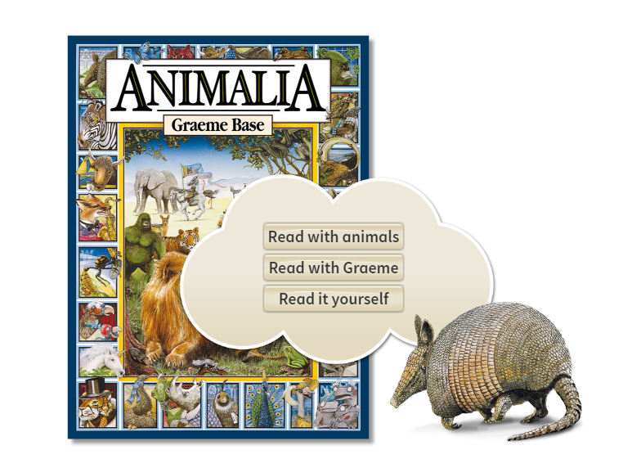
Animalia
Notes:
When you select Animalia, the book – you can then select narrator (either animals or the author Graeme Base) or you can read it yourself.

Slide 7
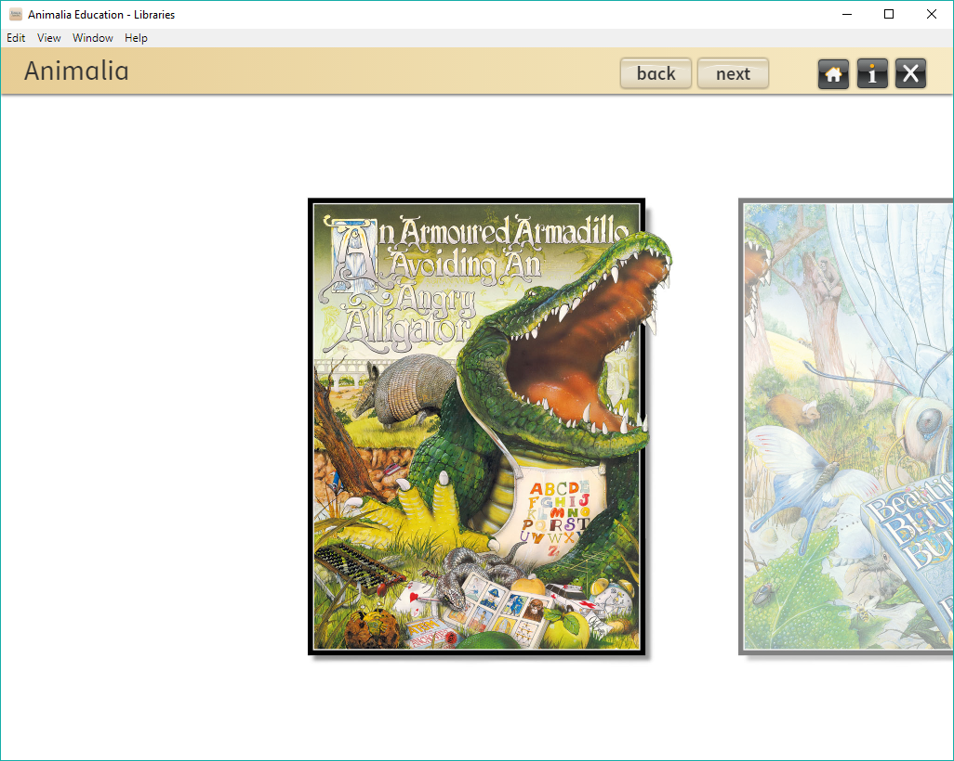
Animalia
Notes:
Navigating Animalia, the book – you’ll want to swipe across pages but you need to click ‘next’ and ‘back’ (top toolbar)
On a pc, Toggle to full screen – either F11 or click View (in the browser) – & select option to toggle to full screen

Slide 8
Animalia
Notes:
You need to download each of the activities the first time you wish to use them. They do not download automatically. The activities are greyed out until they are downloaded.
Click on an activity to download it.
Once an activity has been downloaded, the image is now in colour and the activity can be accessed.

Slide 9
Activities
Notes:
Once you click on each activity, read and/or listen to the instructions that appear at the bottom of the screen. You can repeat the instructions by clicking on the small boy at the bottom right hand side of the screen.
Then select the educational level at the top left hand of screen to begin the activity.
They are foundation (blue), one/two (red), three/four (green) and five/six (yellow).

Slide 10
Screen navigation
Notes:
Top of screen right – open book symbol has instructions about the activity
Other symbols = Home icon; Small “i”= information about the app; x = will close the app & you will need to login again.
Each time the you reopen the Animalia eresource you will need to renter the code - slq123.
You must be online when you do this to authenticate. However, once the app is open, if you wish you can turn off your internet or mobile data connection as the app can be used offline.

Slide 11
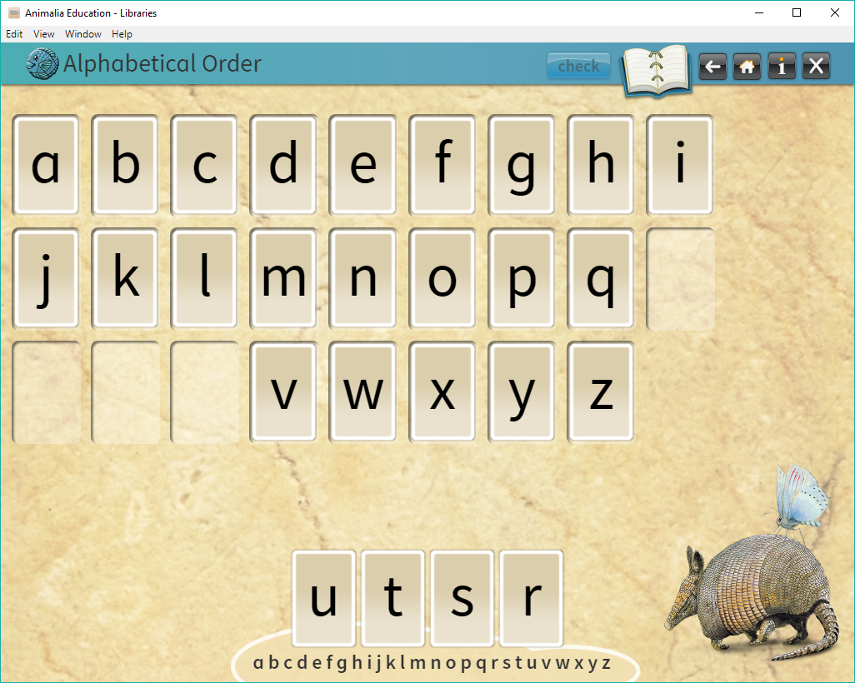
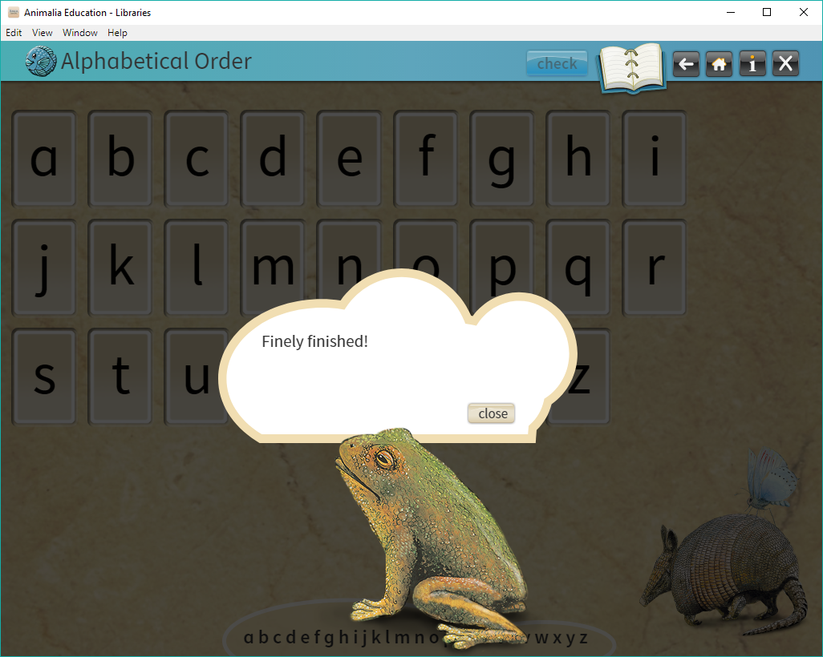
Animalia
Notes:
Activities range from Foundational level – check your answers & receive confirmation.

Slide 12
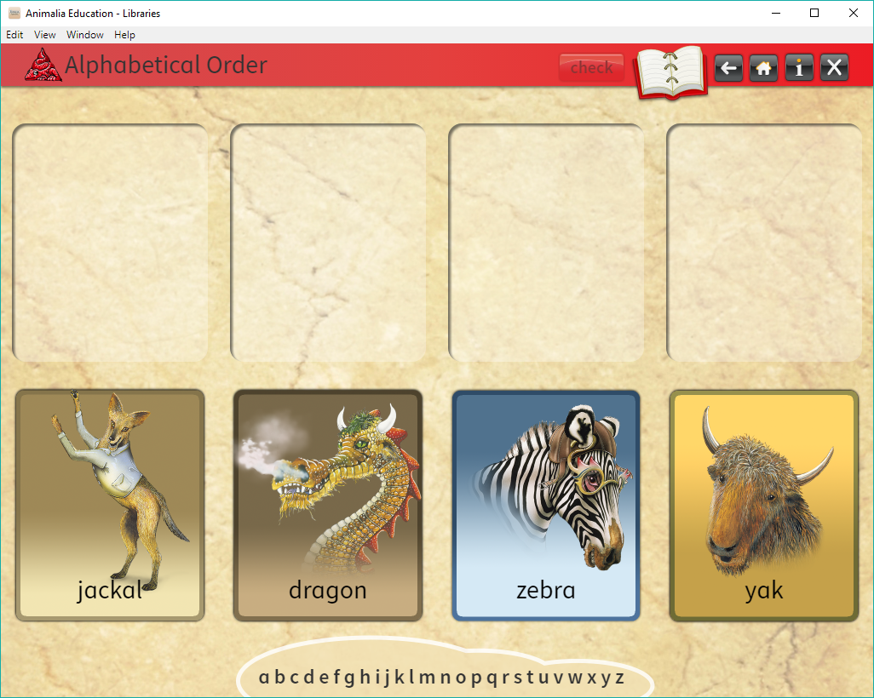
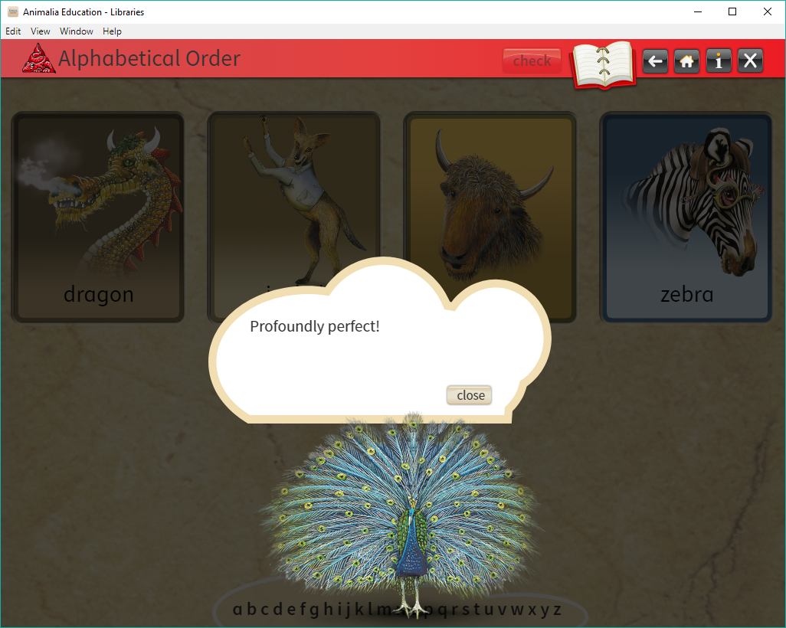
Animalia
Notes:
Next activity in the range is level one/two (red) – drag the tiles to the empty squares in alphabetical order, check your answers & receive confirmation.

Slide 13
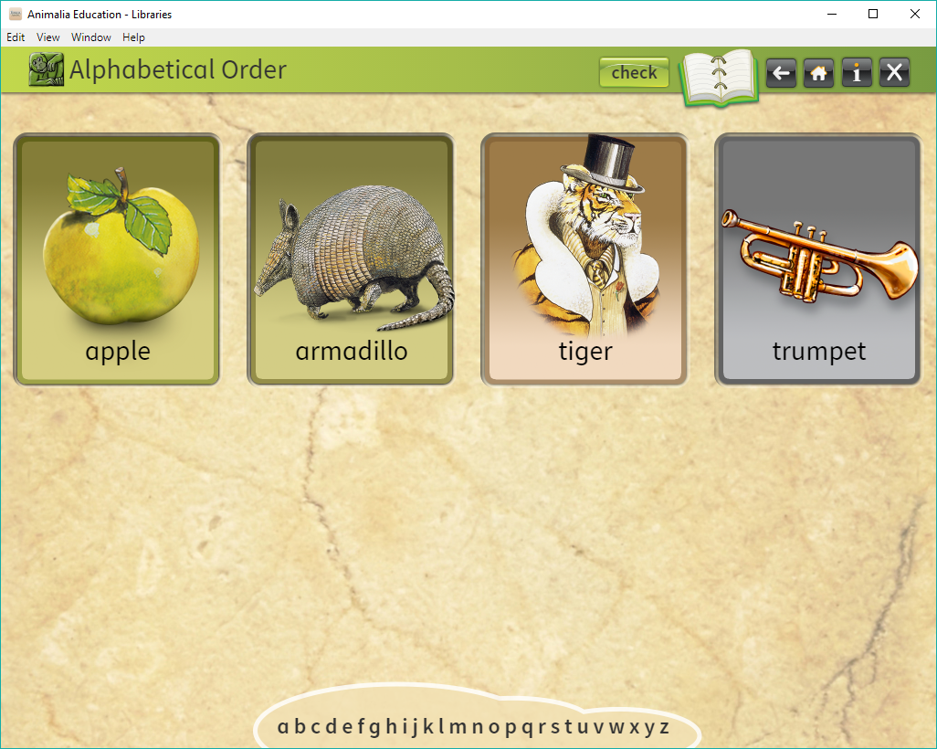
Animalia
Notes:
Activities here range from level three/four (green) to level five/six (yellow) with increasing complexity – check your answers & receive confirmation.
Children progress through a range of levels as they gain expertise. All the activities focus on learning literacy and language. Memory games, quizzes, fun facts, things to find and other great challenges keep kids coming back for more.

Slide 14
Animalia - Help
eresources@slq.qld.gov.au
Notes:
Promotion
Let your community know about this new eresource and the fun they can have.
Printed guide for customers
Poster
Desktop icon
Printed promotion material from supplier available
Statistics
With no authentication process via library barcodes there can be no local statistics – statistics will be state-wide and will count the number of app downloads – not number of page views or activity downloads
Troubleshooting
For questions about Animalia (Library Edition) not covered on the Library support page please email support@thebasefactory.com or eresources@slq.qld.gov.au

